Slide 1

Acropolis Institute of Technology & Research, Indore
www.acropolis.in

Slide 2
Drishti : AI-based Smart Surveillance System
(Intelligent Surveillance System for Real-time Headcount and Recognition)
Submitted to: Department of Computer Science and Engineering
22 Sep 2025

Slide 3

Team Members 1.Riya Kaushal
2.Reeti Shrimal
3.Priyal Waghmare
4.Mandisha Mirza
5.Priyanka Chirote
Supervised by:
Prof. Akshay Dubey

Slide 4
Project Presentation Outline
Introduction
Problem Statement
Survey of Existing Systems
Project Objectives
Requirement Analysis
Solution Proposed
Features
System architecture
User Interface
Testing Plan
The Outcome Discussion
Conclusions

Slide 5
Introduction
.
Project Title: Drishti – An AI-based Smart Surveillance System for Real-time Headcount and Recognition.
About the Project: The system leverages Artificial Intelligence and Computer Vision to detect, count, and recognize individuals in real time. It uses YOLOv8 for person detection and DeepFace for facial recognition, while a web-based dashboard displays live video feed, headcount, and alerts. Unknown individuals are labeled as “Unknown” to ensure privacy.
Solution Provided: Drishti combines computer vision, deep learning models, and a secure database to deliver accurate and privacy-aware surveillance. It automates crowd monitoring, reduces manual supervision, and provides real-time insights through an interactive dashboard. Its modular architecture allows future scalability for multi-camera, cloud, and mobile-based integration.
Motivation: Driven by the limitations of traditional CCTV and rising security needs, the project aims to provide efficient, accurate, and scalable smart surveillance for campuses, offices, and public spaces.

Slide 6
The Problem Statement
Traditional CCTV-based surveillance systems are limited to passive video recording and depend heavily on manual monitoring by security personnel. This leads to several issues such as:
1. Inefficient detection of unusual activity or overcrowding.
2. High chances of human error and delayed response.
3. Lack of real-time alerts and intelligent analysis.
4. Inability to recognize individuals automatically while ensuring privacy.
5. Limited scalability for modern smart city and institutional needs.
Thus, there is a strong need for an AI-powered intelligent surveillance system that can automate real-time person detection, headcount, and facial recognition while maintaining privacy, accuracy, and scalability.

Slide 7
Survey of Existing Systems
S. No. | Project Title | Key Features / Description | Techniques Used | Domain / Application
1 | Real-Time Human Detection and Tracking using YOLO and DeepSORT | Detects and tracks individuals in CCTV streams | YOLO, DeepSORT | Crowd monitoring, surveillance
2 | COVID-19 Social Distancing Monitoring System | Counts people, measures distance for social distancing | YOLOv3, DeepSORT | Pandemic control, public safety
3 | Smart Surveillance System using Face Recognition | Recognizes faces from pre-stored dataset | Haar Cascade, LBPH, DeepFace | Campus security, identity verification
4 | Automated Attendance System using Face Recognition | Captures faces and marks attendance automatically | CNN, DeepFace | Schools, workplaces
5 | Crowd Density Estimation using Computer Vision | Counts individuals to estimate density | Object detection, CNN | Event safety, public gatherings

Slide 8
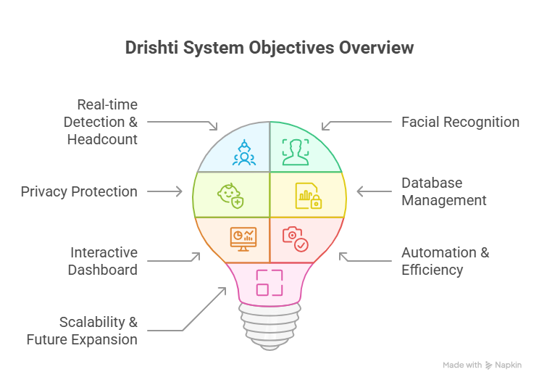
Objectives
The primary objectives of Drishti: An AI-based Smart Surveillance System are:
Real-time Detection & Headcount – To detect and count individuals using YOLOv8 with high accuracy.
Facial Recognition – To integrate DeepFace for recognizing known individuals and displaying their details.
Privacy Protection – To label unrecognized individuals as “Unknown” without storing their data, ensuring data privacy.
Database Management – To design a secure and scalable database for storing recognized identities and historical records.
Interactive Dashboard – To develop a web-based interface that shows live video feeds, headcount, alerts, and recognition results.
Automation & Efficiency – To reduce dependence on manual surveillance and minimize human error.
Scalability & Future Expansion – To build a modular system that can later support multi-camera setups, cloud storage, and mobile notifications.

Slide 9
Requirement Analysis
Functional Requirements
Real-Time Person Detection: Detect individuals in video frames using YOLOv8 and provide live headcount.
Facial Recognition: Identify known individuals via DeepFace; unknown individuals labeled as “Unknown.”
Dashboard & Visualization:
1.Live video feed display.
2.Real-time headcount and recognized individual details.
3.Historical logs and statistics.
Database Management: Secure storage of recognized individuals’ data, headcount logs, and timestamps.
Alerts & Notifications (Future Scope):
Overcrowding alerts.
Mobile app notifications for security personnel.
System Scalability (Future Scope): Multi-camera support, cloud integration, and large-scale deployment.

Slide 10
Continue
2. Non-Functional Requirements
Performance: Real-time processing with minimal latency; optimized CPU/GPU usage.
Security & Privacy:
1.Unknown individuals’ data is not stored.
2.Secure communication via HTTPS/SSL.
3.Optional dashboard access authentication.
Usability & Accessibility: Intuitive and responsive dashboard; high-contrast colors, clear icons, and easy navigation.
Reliability & Availability: Continuous operation without crashes; secure and consistent database storage.
Scalability & Extensibility: Modular design to support future multi-camera setups, cloud storage, and mobile integration..
22 Sep 2025
Department of Computer Science
Engineering

Slide 11
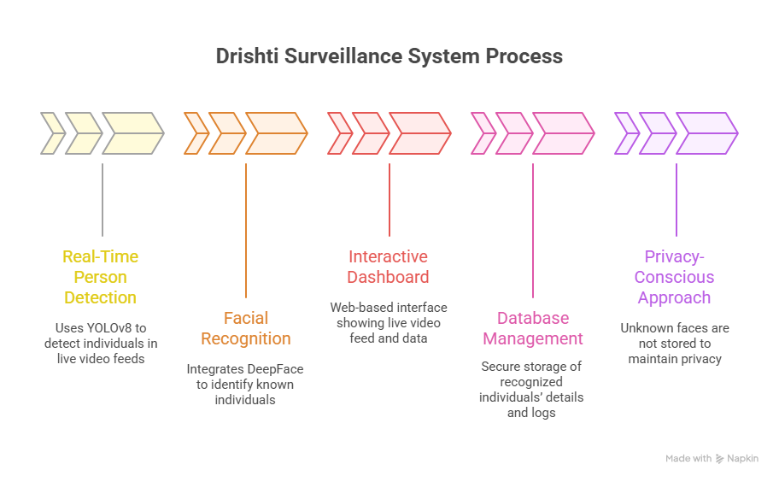
Solution Proposed
The proposed solution for Drishti is:

Slide 12
Features
Features of Drishti :
Real-Time Person Detection
Detects individuals in live video feeds using YOLOv8.
Provides instant headcount for monitoring crowd density.
Facial Recognition
Identifies known individuals using DeepFace.
Labels unknown persons as “Unknown” to maintain privacy.
Interactive Dashboard
Web-based interface for live video feed, headcount, alerts, and recognized persons.
Displays historical logs and statistics for analysis.
Privacy-Aware Monitoring
Unknown individuals’ data is not stored, ensuring compliance with privacy standards.
Database Management
Stores recognized individuals’ details, timestamps, and headcount logs securely.
User-Friendly Interface
Intuitive, responsive, and clean layout.
Designed for quick monitoring with minimal interaction.

Slide 13
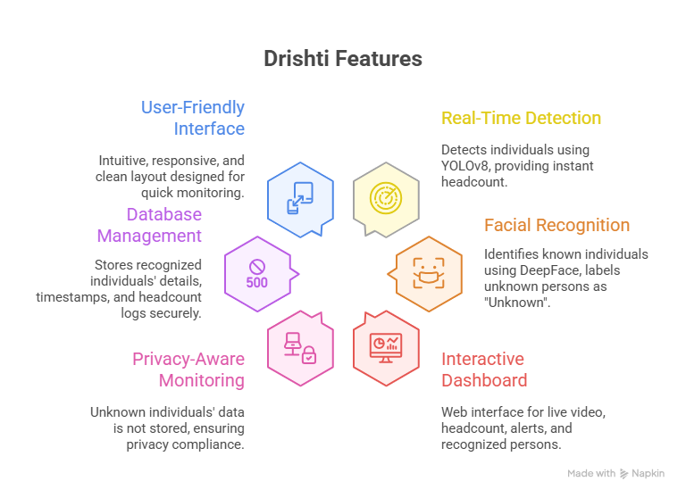
Features
Department of Computer Science
Engineering
22 Sep 2025

Slide 14
System Architecture
The system architecture of the Drishti – AI-based Smart Surveillance System is divided into multiple modules, each performing a specific task to ensure real-time detection, recognition, and secure monitoring.
Main Components:
1. Video Capture & Input Layer Captures live video stream using a webcam or IP camera. The video feed serves as the input for real-time processing and analysis.
2. Person Detection Module (YOLOv8) Performs object detection on each video frame to identify and count individuals. It tracks movement and crowd density dynamically.
3. Facial Recognition Module (DeepFace) Extracts and compares facial features with a pre-stored dataset to identify known individuals. Unknown persons are labeled as “Unknown” to maintain privacy.
4. Backend Processing & Database Management Handles data processing, model integration, and communication between the frontend and database. Stores details of recognized individuals and headcount logs securely.
5. Dashboard & Visualization Layer (Frontend) Displays live video feed, headcount, recognized individuals, and alerts through an interactive web dashboard built using HTML, CSS, and JavaScript/React.

Slide 15
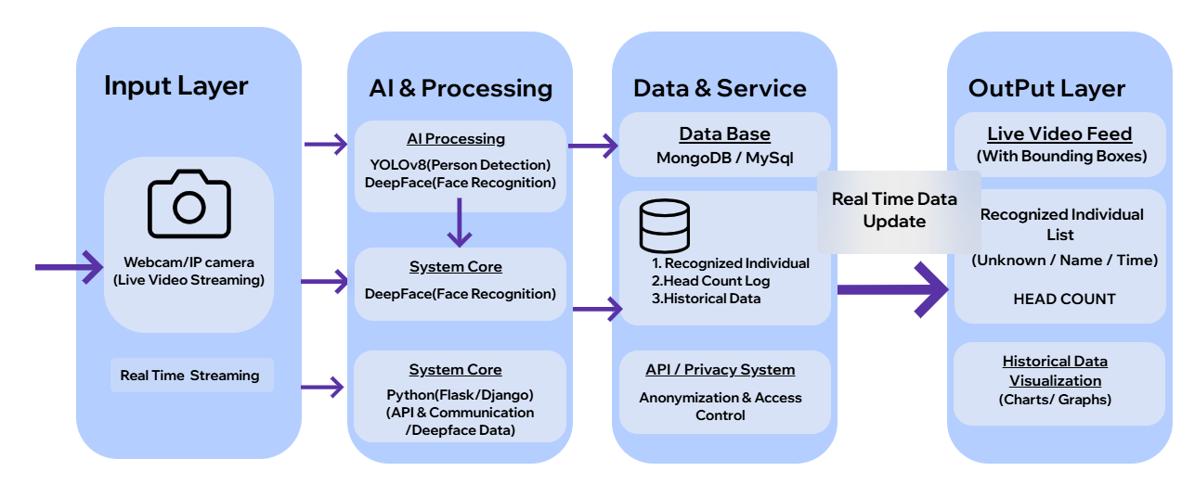
System Architecture Diagram

Slide 16
User Interface
The user interface of Drishti is designed to be intuitive, responsive, and informative, allowing security personnel to monitor real-time video, crowd status, and recognized individuals efficiently. The focus is on clarity, accessibility, and minimal interaction, so that operators can make quick decisions without confusion.
Key Components:
1.Dashboard Layout
Live Video Feed Panel: Displays the real-time camera feed in the largest section of the screen.
Headcount Display: Shows the total number of people detected in real time.
Recognized Individuals Panel: Lists names and details of recognized persons; unknown individuals are labeled as “Unknown.”
2.Navigation & Interaction
Minimal buttons for starting/stopping monitoring.
Hover or click-based details for zone statistics or individual histories.
Responsive design ensures usability across desktops, laptops, and large-screen tablets.
3.Visual Design & Accessibility
High-contrast colors, large fonts, and clear icons for quick visibility of critical information.
Clean layout without clutter to ensure focus on live monitoring and alerts.
Real-Time Updates
Frontend communicates with backend using APIs or WebSockets.
Updates live headcount, recognized individual information, without page refresh.

Slide 17
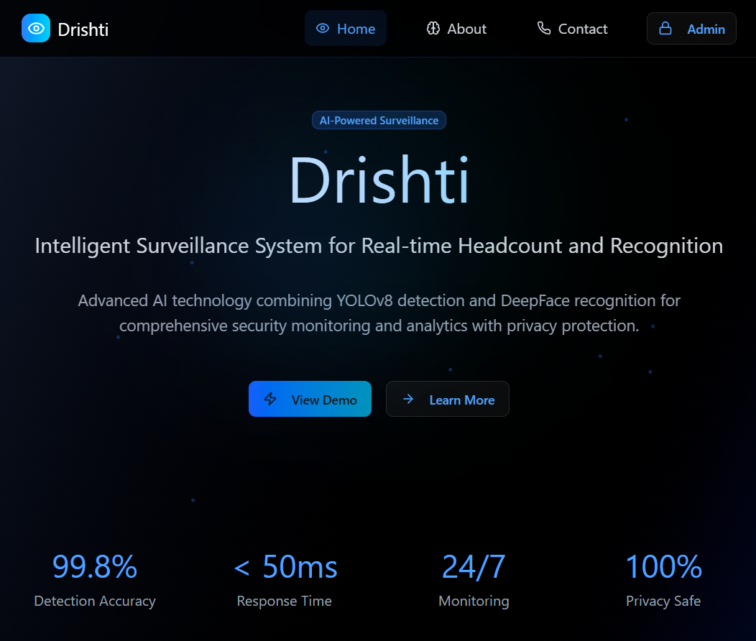
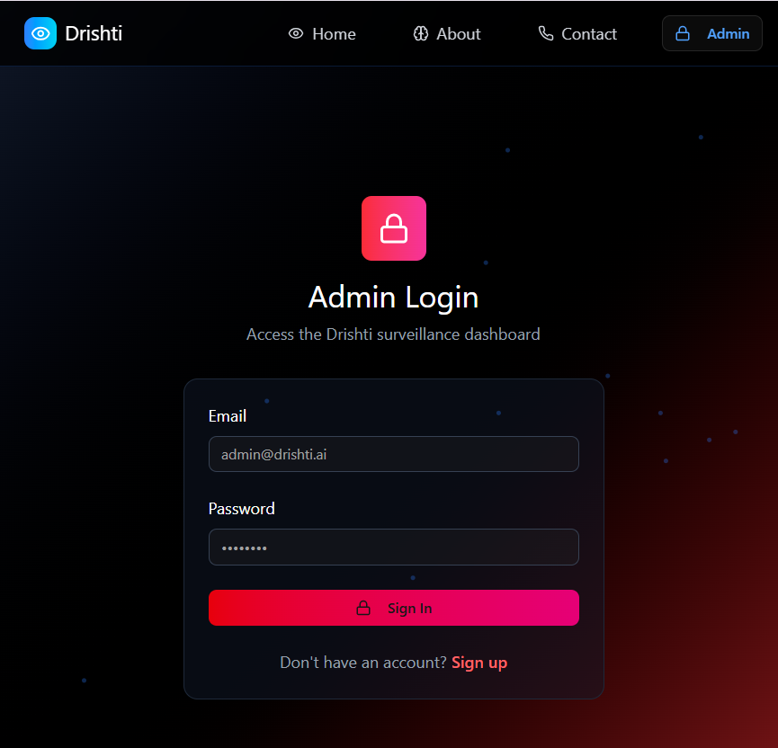
User Interface

Slide 18
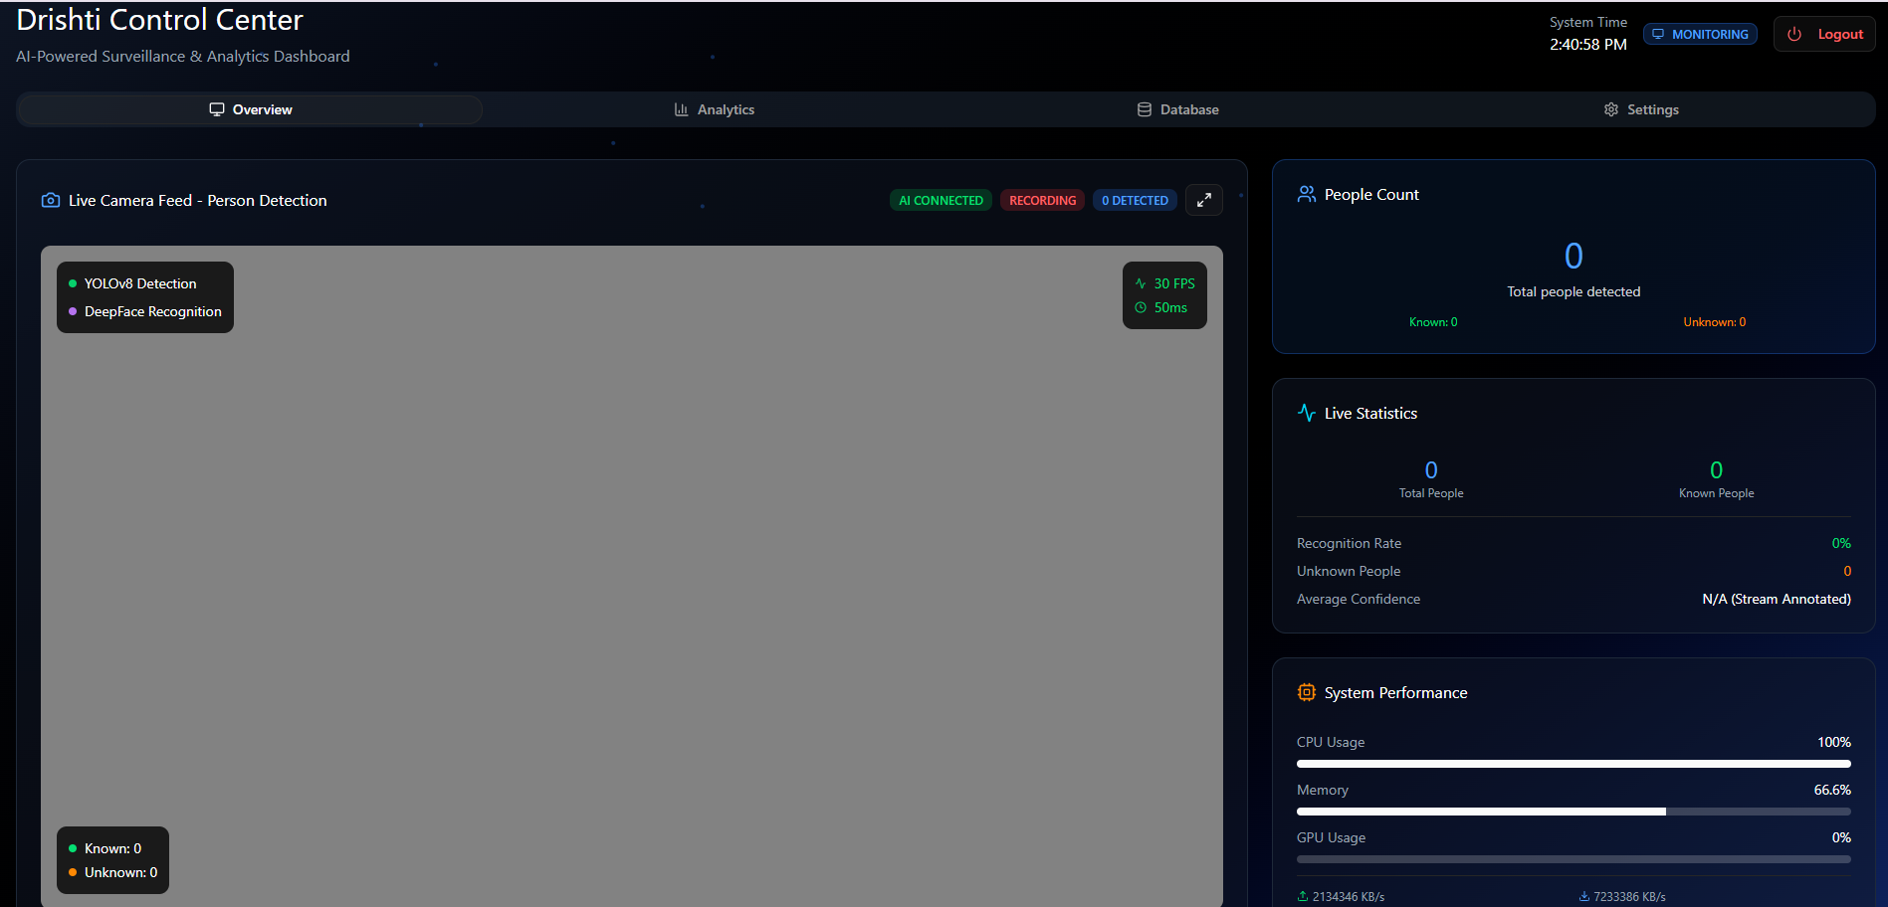
Dashboard

Slide 19
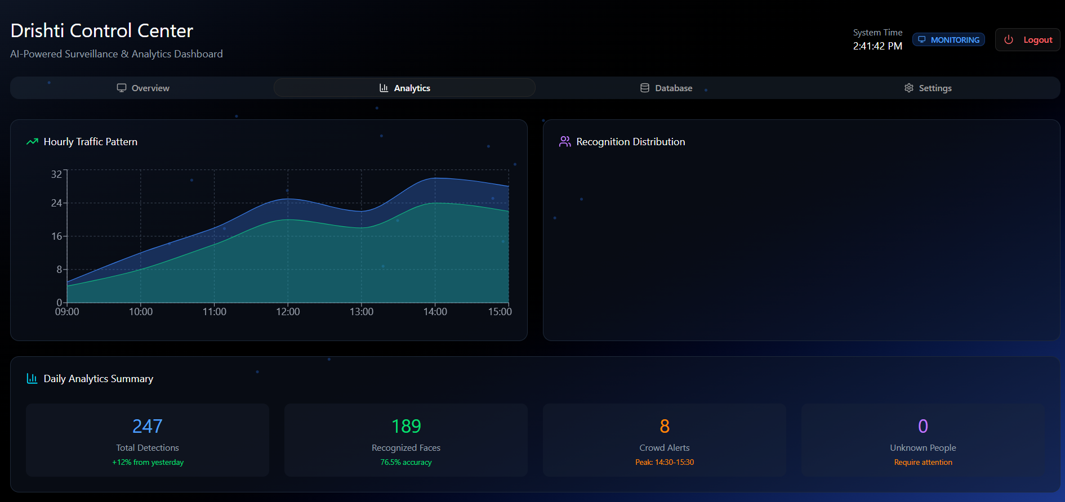
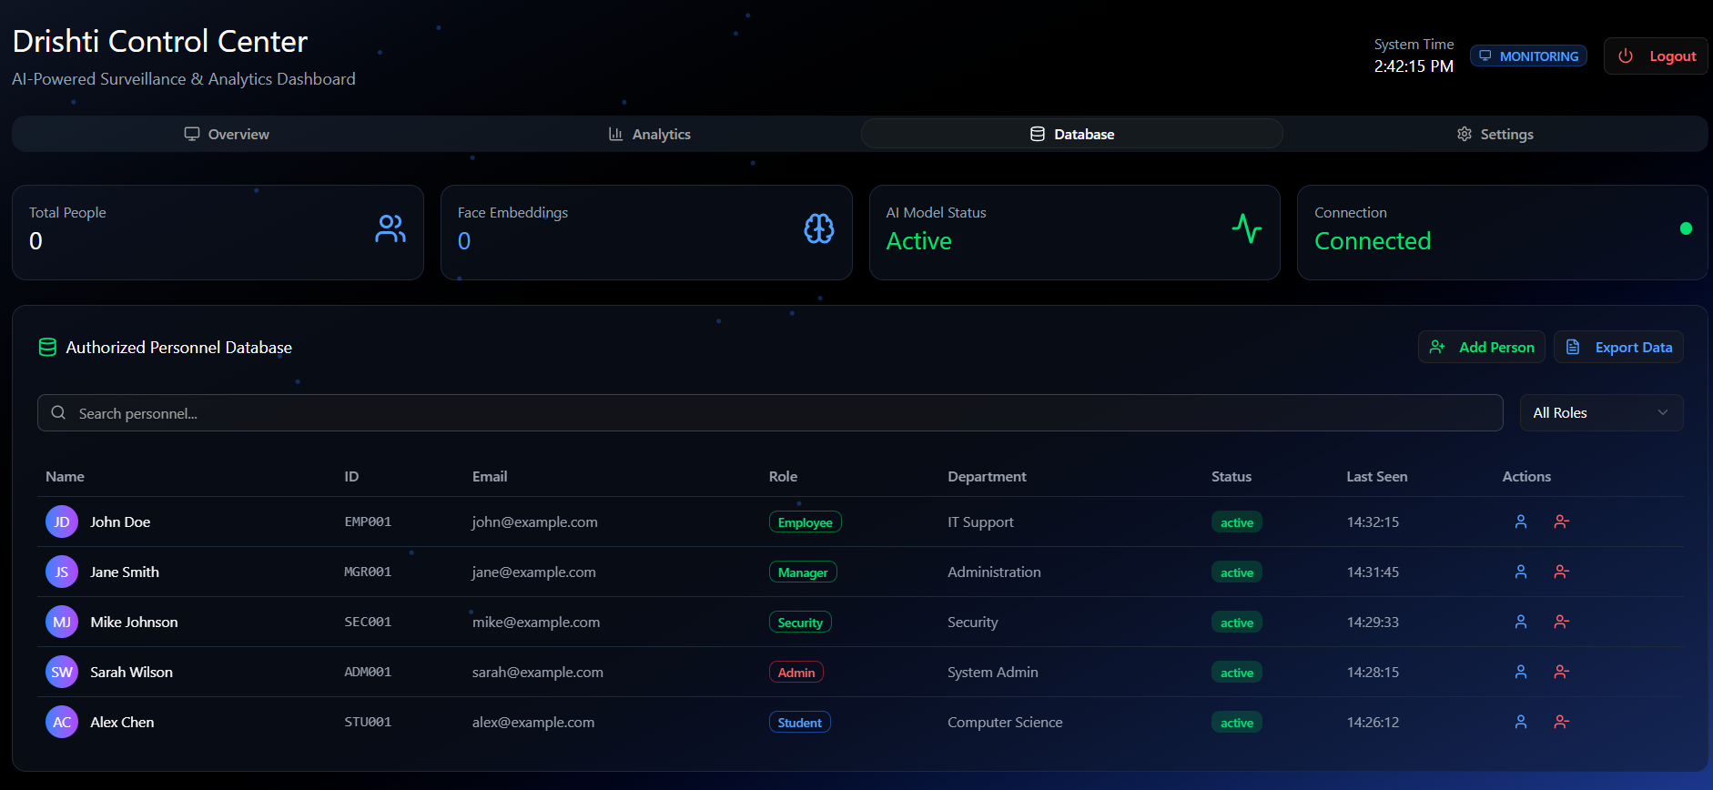
Continue

Slide 20
Testing Plans
To ensure accuracy, reliability, and performance, the Drishti will be tested at different levels.
Types of Testing:
Unit Testing – Test individual modules such as YOLOv8 person detection, DeepFace facial recognition, database operations, and API/WebSocket communication.
Integration Testing – Check smooth data flow between modules: Video Capture → Person Detection → Facial Recognition → Dashboard → Database Logging.
Performance Testing – Verify real-time processing speed (FPS), AI inference time, and system performance under varying crowd densities.
Accuracy Testing – Evaluate detection and recognition accuracy using sample datasets and real-time video feeds.
Robustness Testing – Test system under challenging conditions such as low-light, crowded scenes, occluded faces, or camera angle variations.
Security & Privacy Testing – Ensure unknown individuals’ data is not stored, secure communication (HTTPS/SSL), and access control for the dashboard.
User Acceptance Testing (UAT) – Collect feedback on dashboard usability, and system responsiveness, and make necessary adjustments.

Slide 21
The Outcome
Expected Outcome of the Project Development :
Real-Time Person Detection: Accurately detects and counts individuals in live video feeds.
Facial Recognition: Recognizes known individuals while labeling unknown persons as “Unknown” to ensure privacy..
Interactive Dashboard: Displays live video, headcount, recognized faces, alerts, and historical logs for efficient monitoring.
Automated Monitoring: Reduces the need for manual supervision and enhances operational efficiency.
Data-Driven Insights: Historical logs and headcount statistics support better decision-making and crowd management.
Enhanced Safety & Security: Provides a reliable, real-time surveillance system suitable for offices, campuses, labs, and small public spaces.

Slide 22
Conclusion
Drishti is an AI-based smart surveillance system that effectively integrates real-time person detection using YOLOv8 and facial recognition using DeepFace to provide efficient and intelligent monitoring. The system automatically counts individuals, manages crowd density, and identifies known persons while labeling unknown individuals as “Unknown,” ensuring privacy protection. Its interactive, web-based dashboard allows security personnel to monitor live video feeds, receive alerts, and access historical logs in real time, improving decision-making and operational efficiency. Designed with a modular and scalable architecture, Drishti is capable of future enhancements such as multi-camera support, cloud integration, and mobile notifications. Overall, it offers a reliable, privacy-conscious, and automated surveillance solution suitable for offices, campuses, labs, and small public spaces, laying the groundwork for advanced smart city security applications.

Slide 23
Q&A

Slide 24
THANKS

